Slide 1
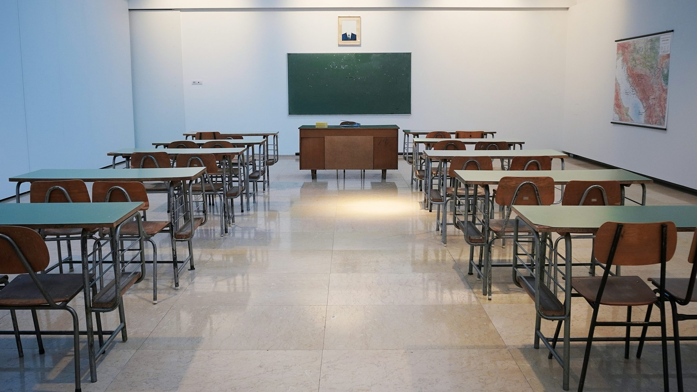
校園故事 (Animaze)
Notes:
https://unsplash.com/photos/brown-wooden-table-and-chairs-PDRFeeDniCk

Slide 2

目標
Notes:
https://unsplash.com/photos/green-arrow-goes-straight-to-center-of-dartboard-reaching-the-goal-of-success-business-goal-setting-3d-render-illustration-4wRin-wsqjM

Slide 3

阻礙
Notes:
https://unsplash.com/photos/tried-young-asian-office-employee-feeling-sick-and-have-a-headache-from-a-long-working-day-at-office-gpnFPMj1BCQ

Slide 4
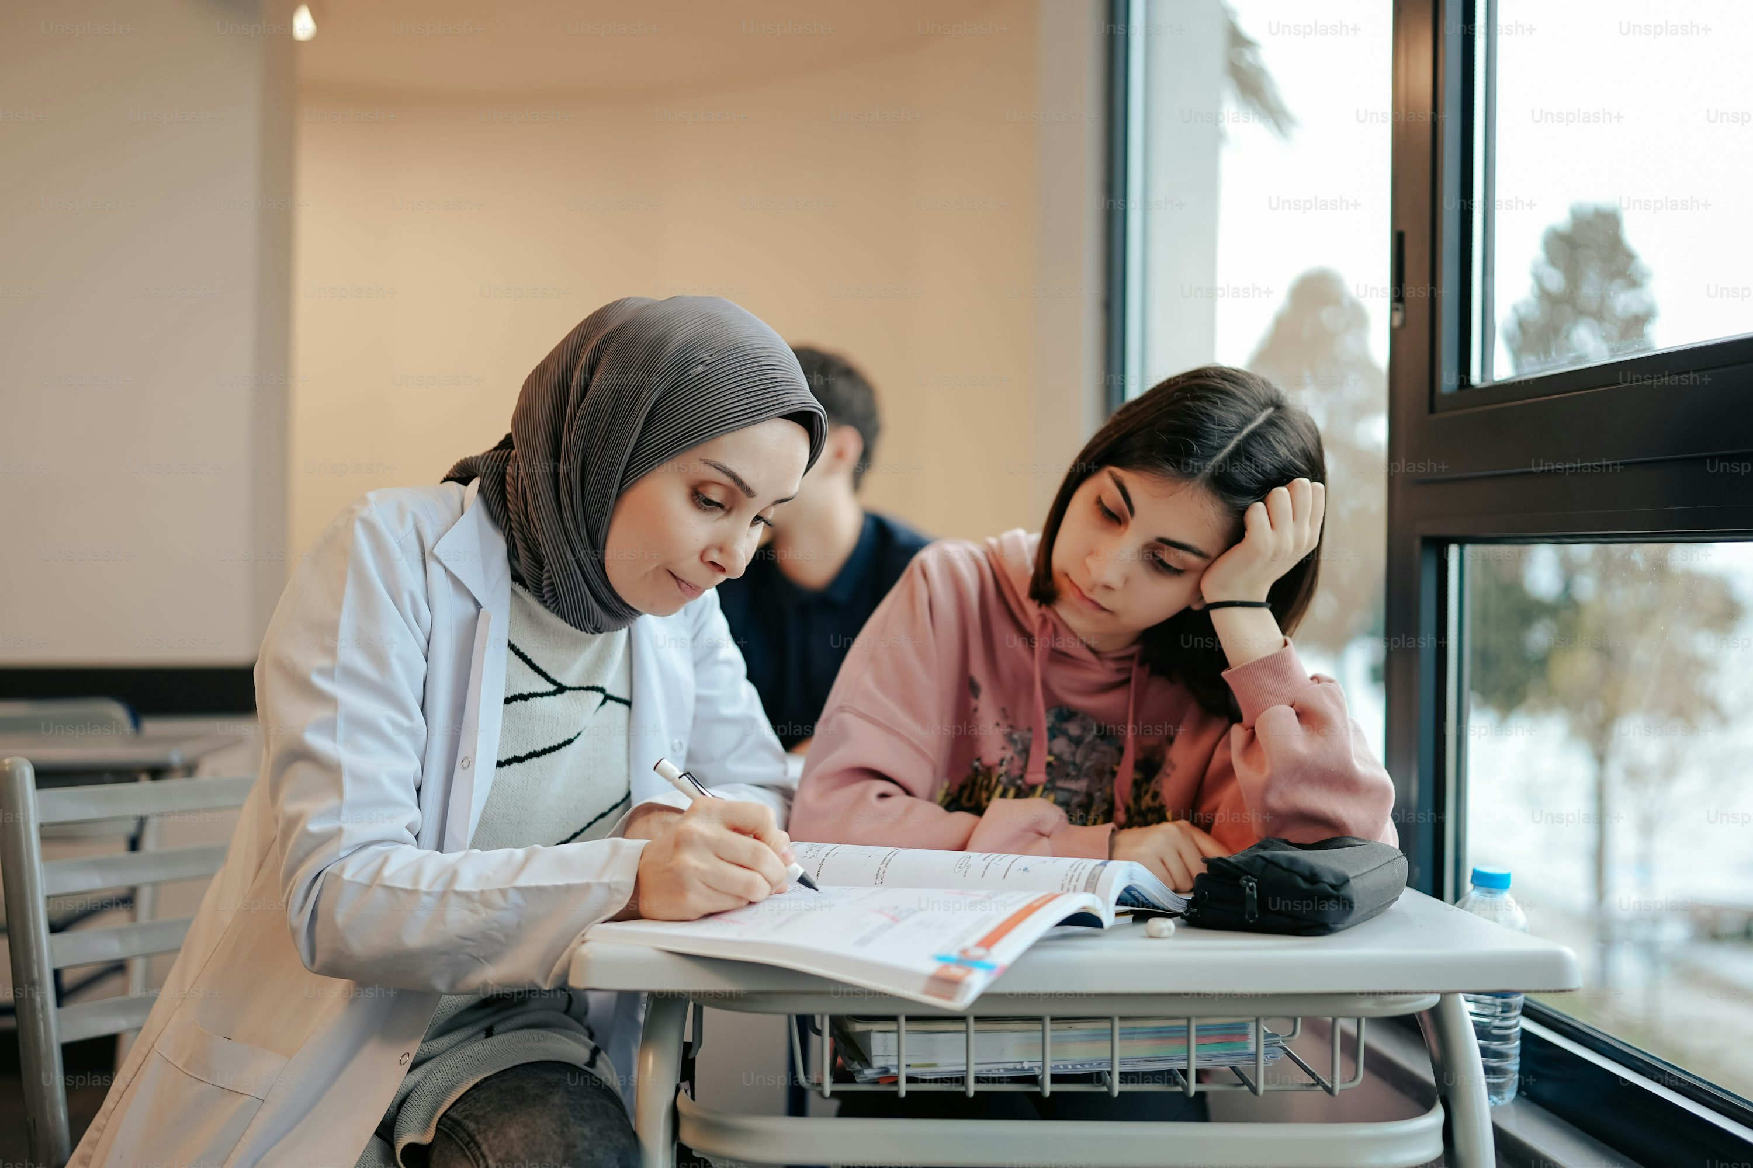
努力
Notes:
https://unsplash.com/photos/two-people-sitting-at-a-table-with-a-book-KnvVIUw8EIw

Slide 5
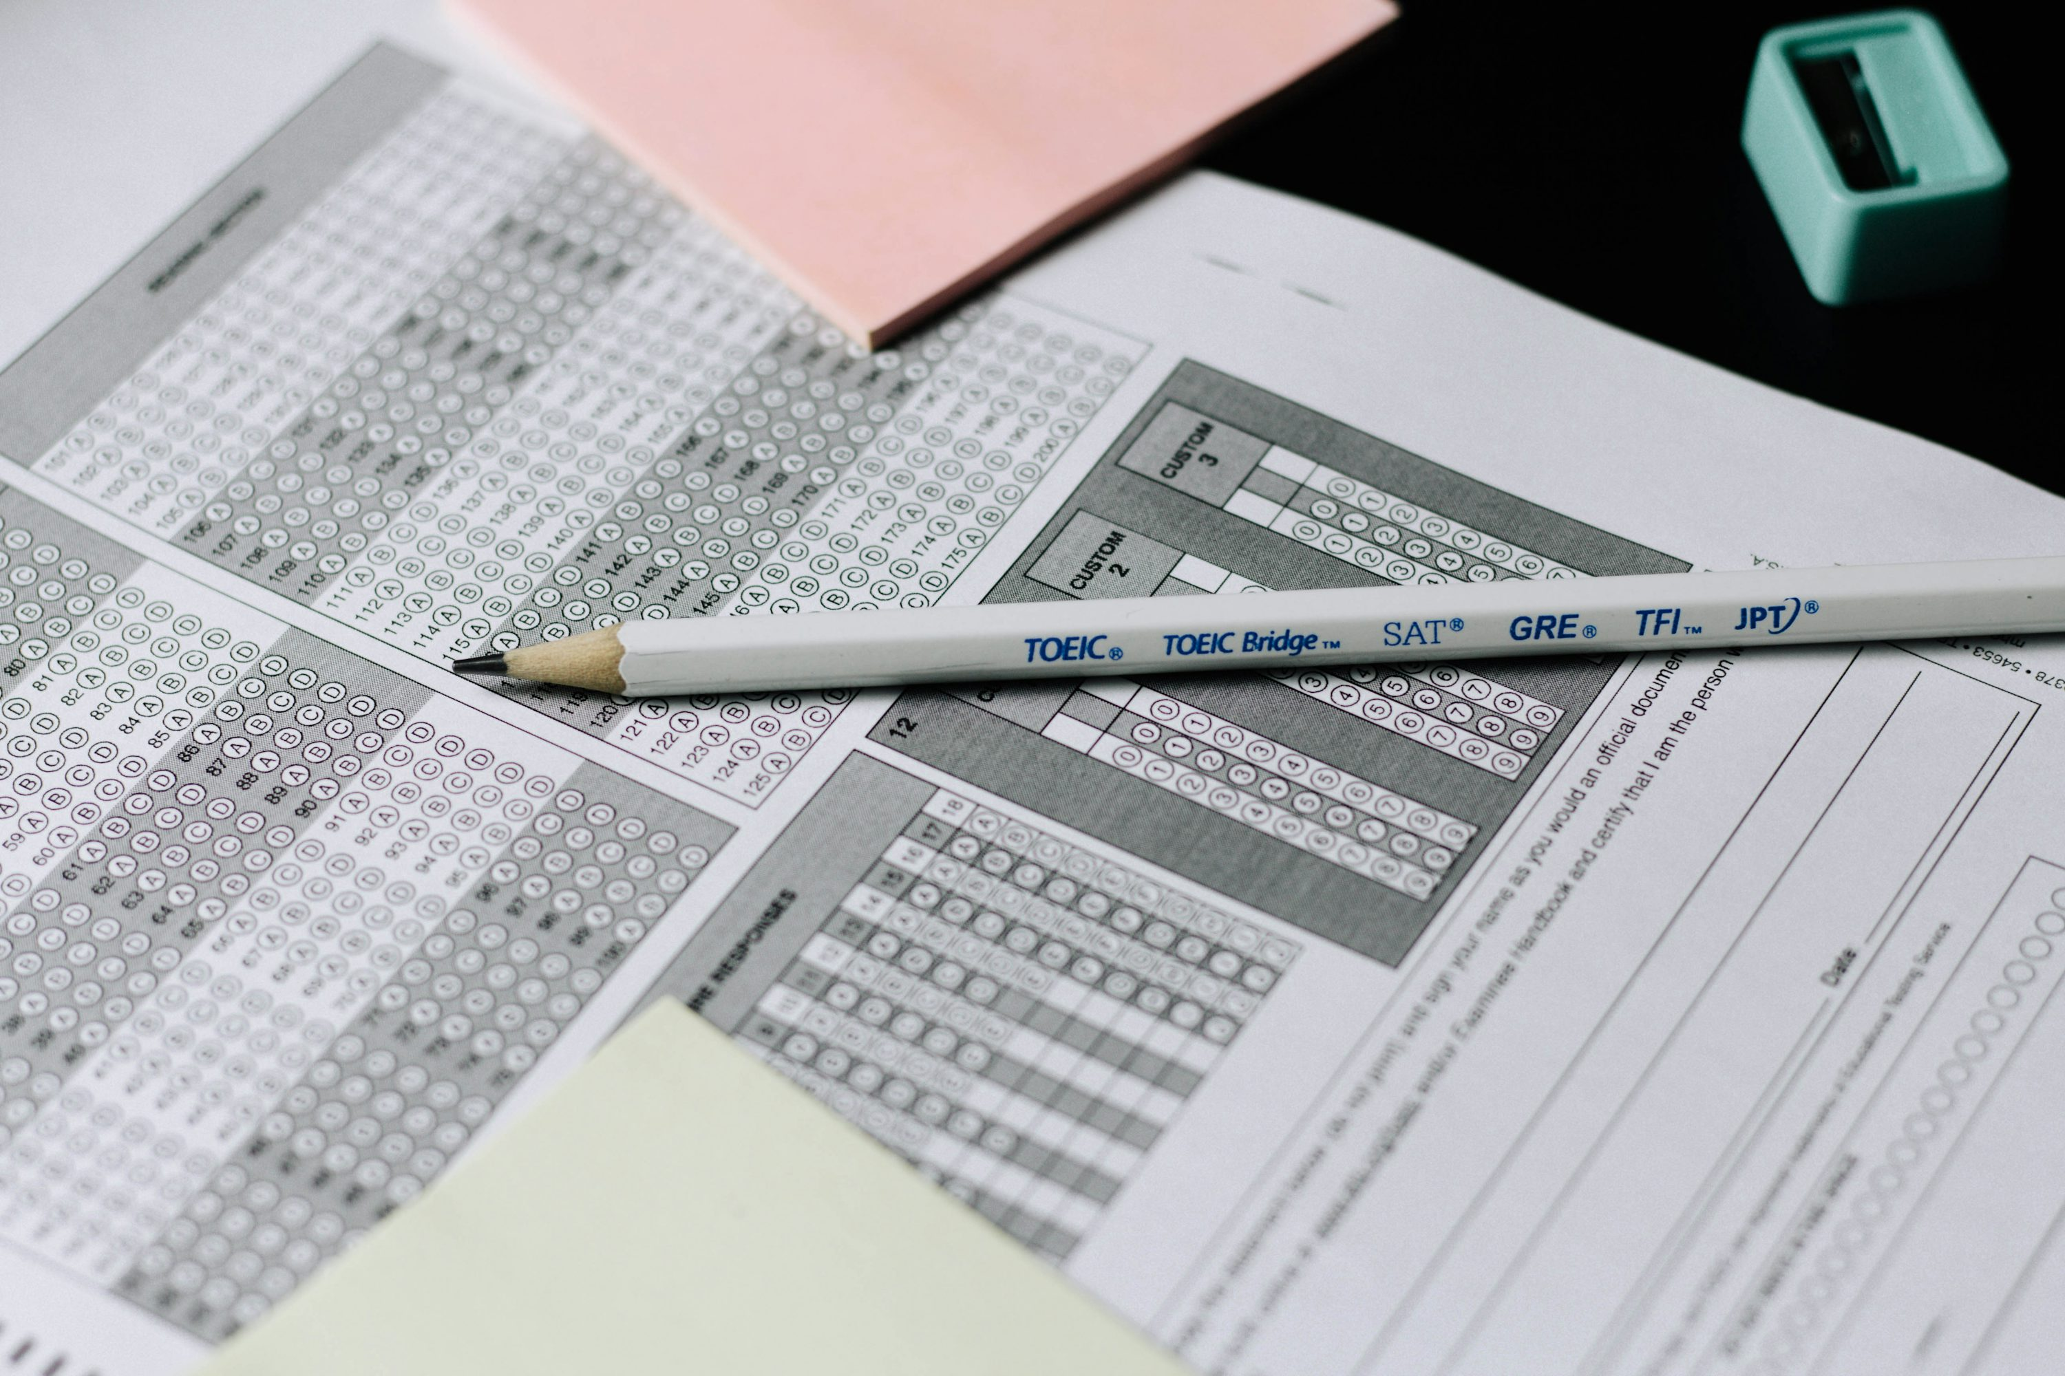
結果
Notes:
https://unsplash.com/photos/gray-and-white-click-pen-on-white-printer-paper-cbEvoHbJnIE

Slide 6

意外
Notes:
https://unsplash.com/photos/monitor-showing-java-programming-OqtafYT5kTw

Slide 7

轉彎
Notes:
https://unsplash.com/photos/business-people-working-office-corporate-meeting-team-startup-concept-SHJYMYUGSNY

Slide 8

結局
Notes:
https://unsplash.com/photos/a-smiley-face-wearing-a-graduation-cap-iMfG5py52LA

